Slide 1

Module 6: Architectural Design
Part III
Software Engineering
School of Computing, Faculty of Engineering
Universiti Teknologi Malaysia

Slide 2
Component diagram as an implementation view
Existing framework, legacy system, existing system, hardware driver, Web service provider

Slide 3
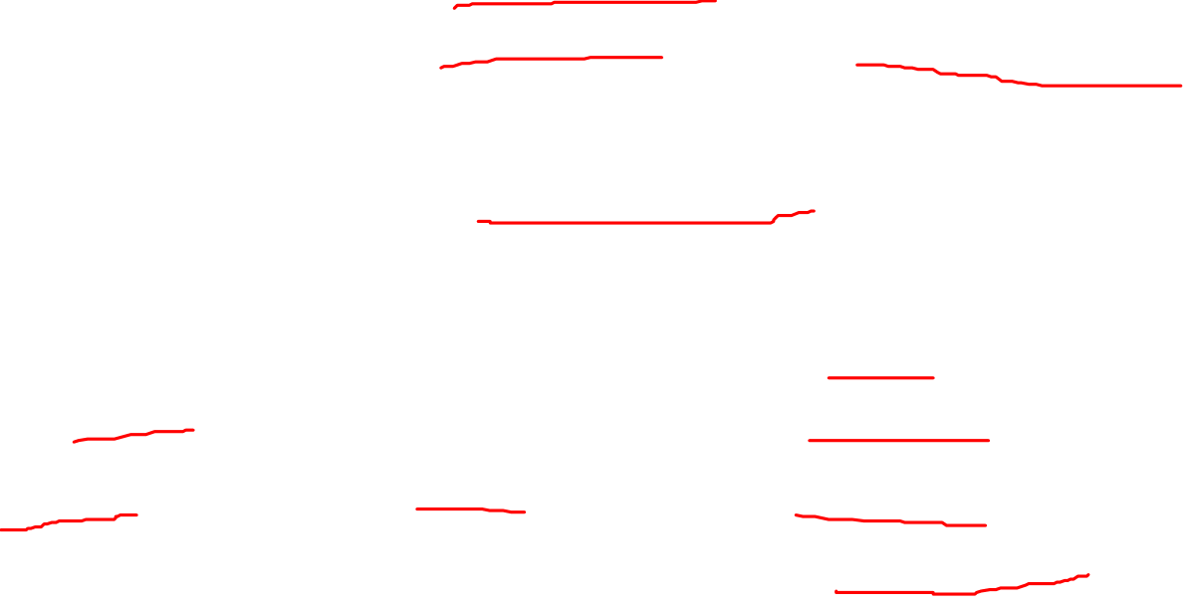
UML Component Diagram
Used to model the top-level view of the system design in terms of components and dependencies among the components
Components can be linkable libraries, executables
Components can be identified based on influence from the system environment e.g. existing framework used for the software, connection to legacy system or external system, hardware driver used and also if the software used any web service available
Source: Bennett, McRobb and Farmer (2010)

Slide 4
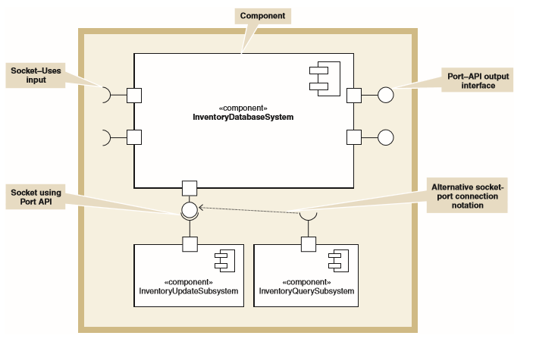
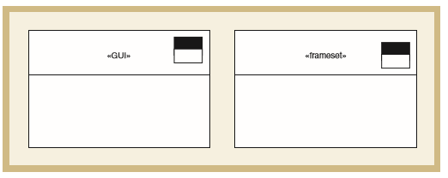
UML Component Notation and Extension Notation for Windows and Web page
Source: Satzinger (2011)

Slide 5
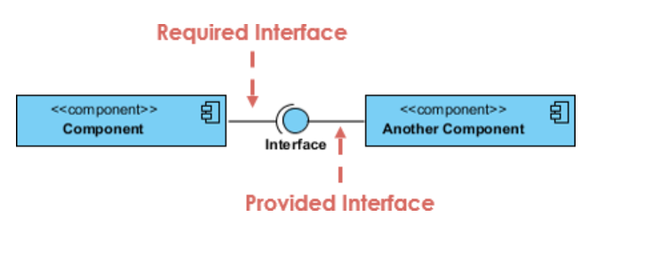
Types of Interface in Components
A UML interface describes a group of operations used or created by UML components
2 types of interfaces: provided and required interfaces:
  A provided interface is modeled using the lollipop notation
  A required interface is modeled using the socket notation
Source: Bennett, McRobb and Farmer (2010)

Slide 6
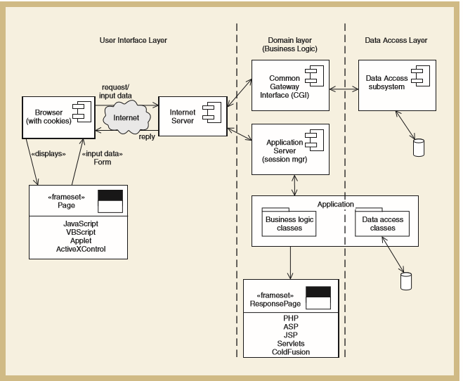
Influence from the System Environment: Existing Framework
Choice of OS, database and programming language and the way to which the new components will be chosen, designed and interconnected
e.g. adopting J2EE or Microsoft.NET will expect the new system to fit the framework
Component diagram based on web based system framework

Slide 7
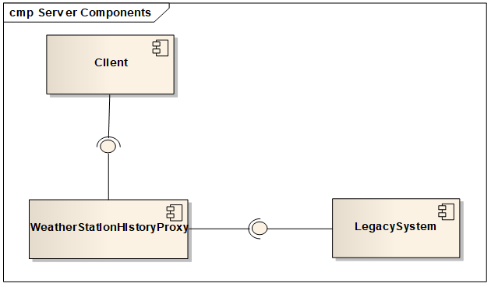
Influence from the System Environment: Legacy System
The technology used to develop them are out of date and difficult to support
The system operates on out of date technology but still have a clear benefit to the business
The new system need to access the data from legacy system using a wrapper

Slide 8
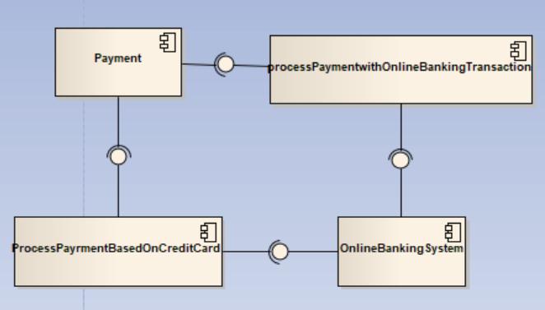
Influence from the System Environment: External System
The new system needs data from the external system
Have to be connected to the external system provided service

Slide 9
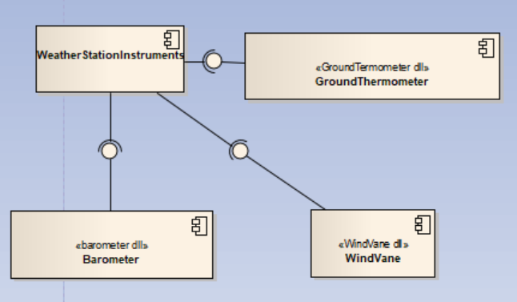
Influence from the System Environment: Hardware Driver
If there is hardware involved especially the usage of sensor or actuator, a dll library is needed as a component driver to link the hardware to the new system

Slide 10
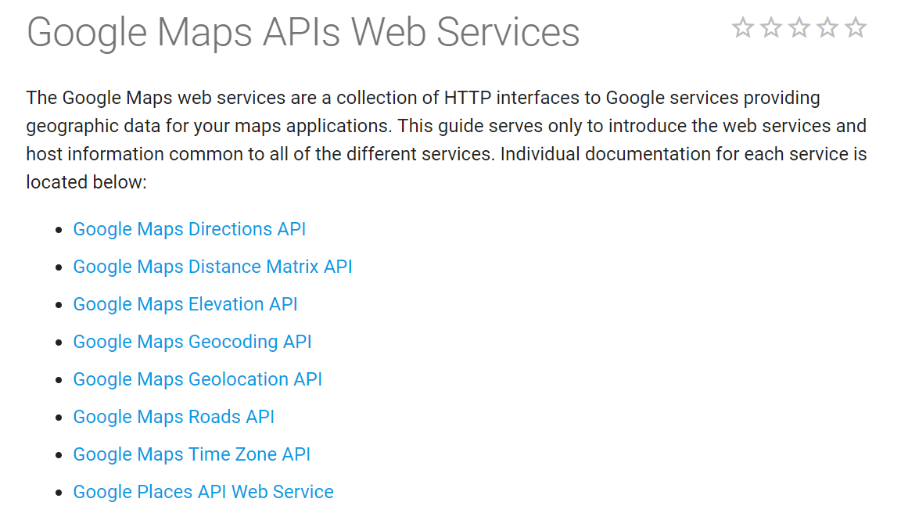
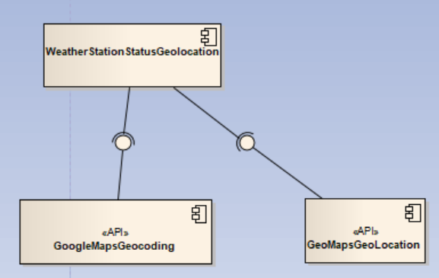
Influence from the System Environment: Web Service
The new system needs an available API from a Web service

Slide 11
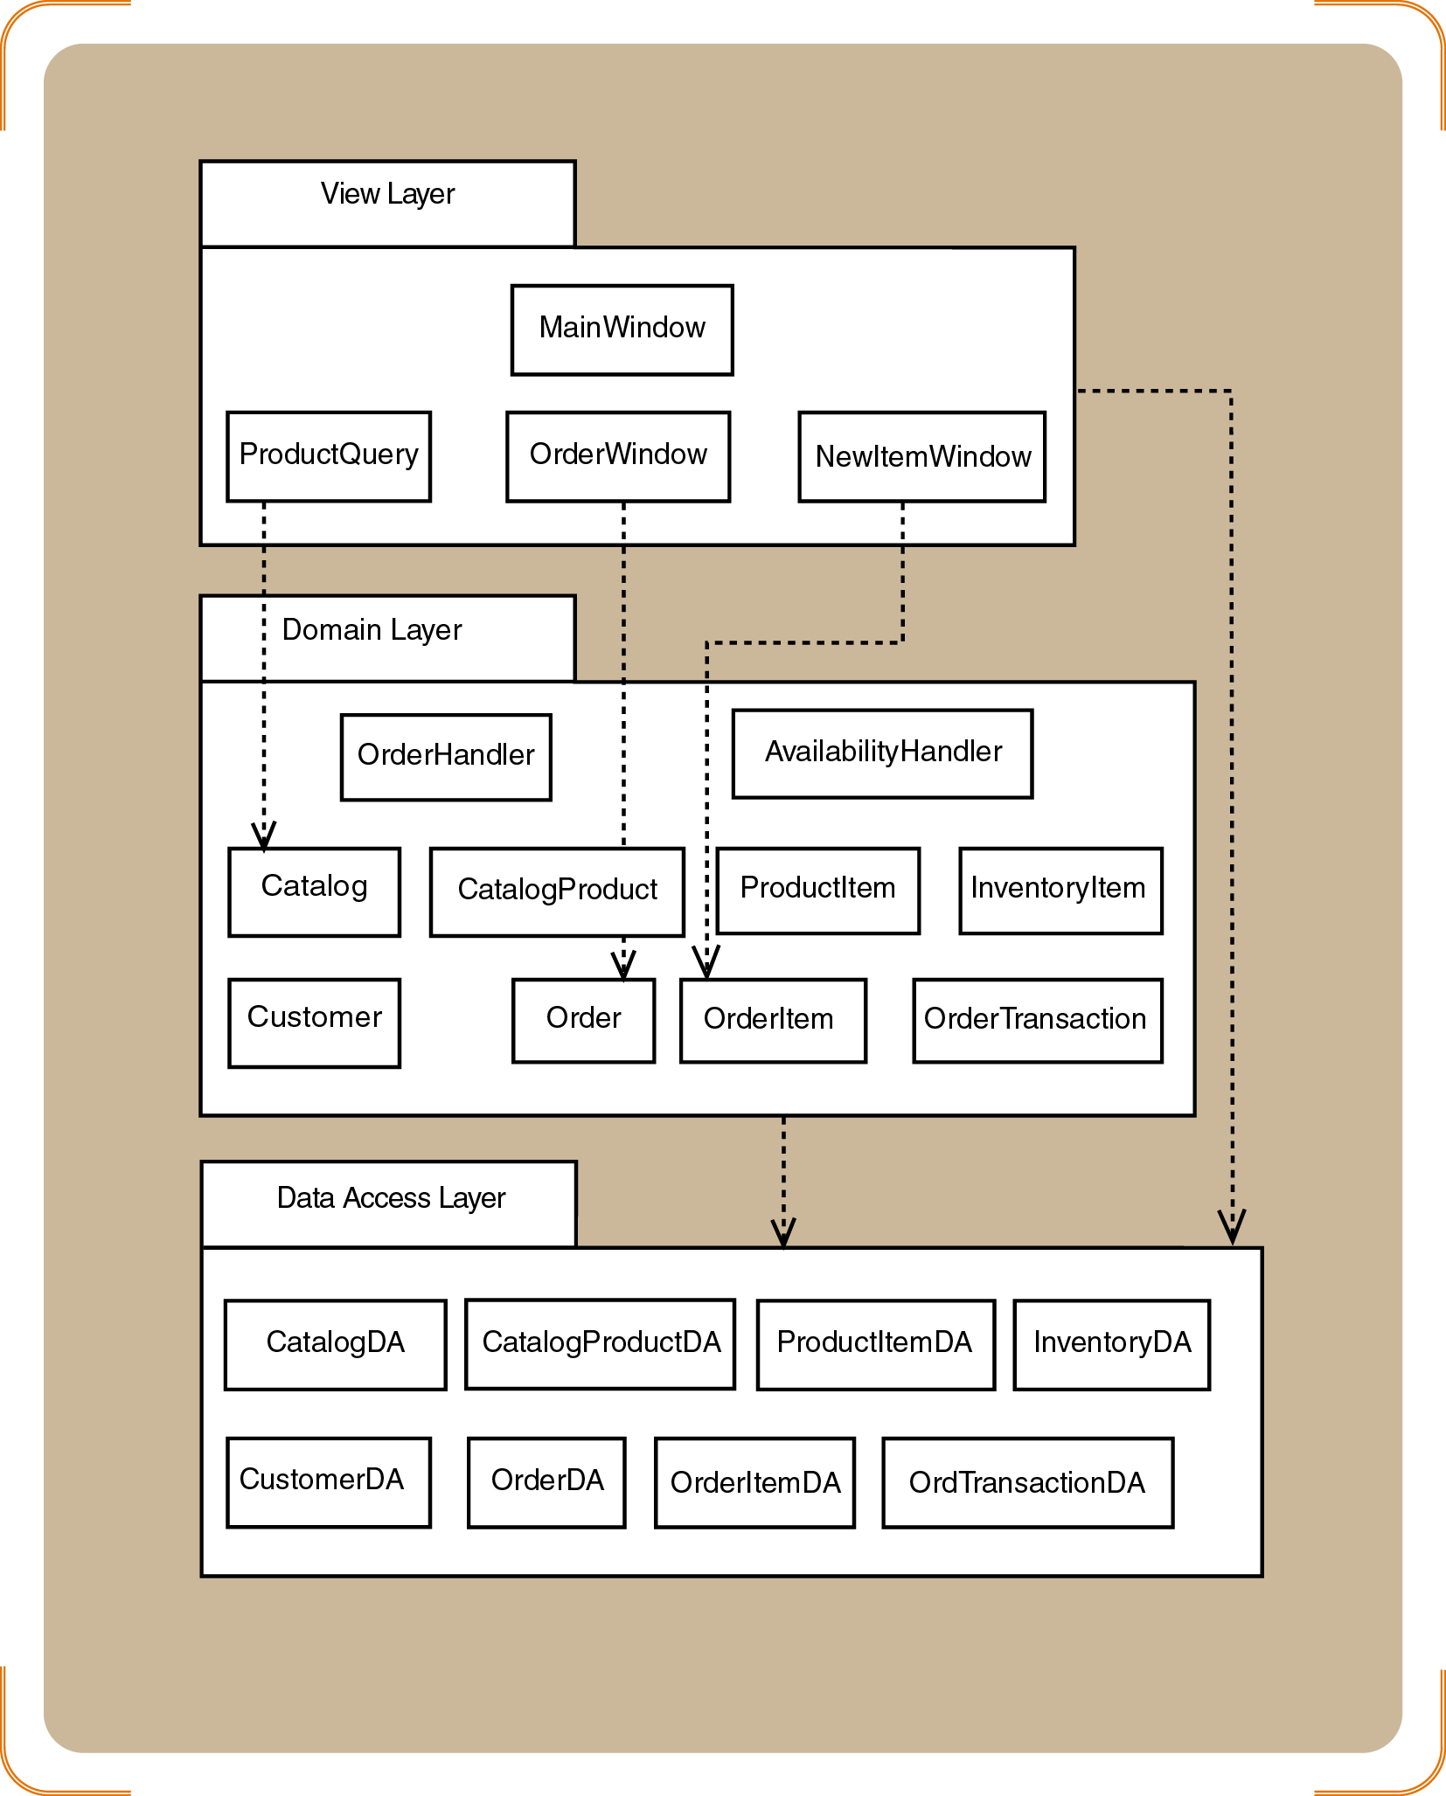
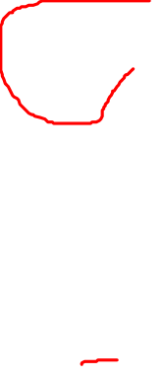
Combination of Architectural Style: Layered, Subystems and Components

Slide 12
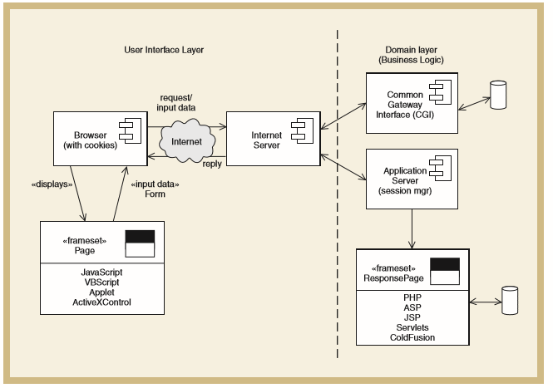
Example: Two-Layer Architectural Design of Internet Systems
Source: Satzinger (2011)

Slide 13
Example: Three-Layer Architectural Design of Internet Systems
Source: Satzinger (2011)

Slide 14
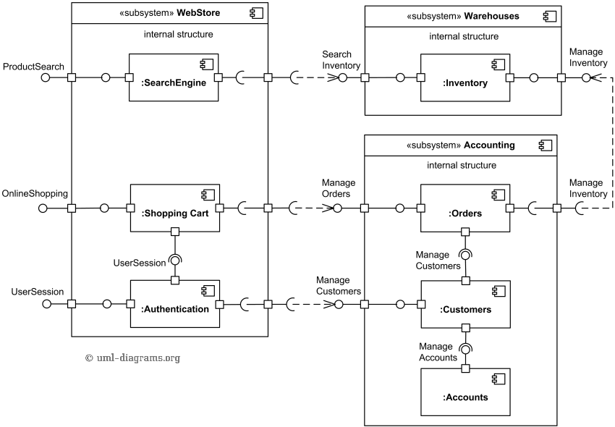
Example: Component Diagram for Online Shopping
Source: https://www.uml-diagrams.org/examples/online-shopping-uml-component-diagram-example.html

